Slide 1
PROMPT CODING | EXPERIMENT
AI Image Analyzer
Testing the limits of Claude Code in practice: from idea to working web app — using prompts only
Dmitry Onyshchenko · February 2026
Flask
Python
Gemini AI
Claude Code
Prompt Coding

Slide 2
1. Problem Statement
What we wanted to test
“Can you build a real production-ready web app without writing a single line of code manually?”
🧪 Hypothesis
🛠 Tools
✅ Success Criteria
▸ Prompt coding can produce
▸ Claude Code (claude.ai/code)
▸ Multiple working AI scenarios
▸ a fully functional web app
▸ Gemini 2.5 Flash Lite (free)
▸ Proper error handling
▸ without manual coding
▸ Flask + Python + Pydantic
▸ AI does everything itself — including this presentation
⚡ Constraint:
all code created exclusively through prompts. No changes made manually in an editor. Weekend project — under 8 hours total.

Slide 3
2. Prompt Coding + Claude Code
A new approach to software development
❌ Traditional Development
✅ Prompt Coding + Claude Code
Open IDE, write code line by line
Describe your intent in plain language
Google APIs / Stack Overflow
AI reads the codebase, writes the code
Spend time on boilerplate
→
Focus on ARCHITECTURE and INTENT
Focus: HOW to implement
Focus: WHAT it should do
First result: hours or days
First result: minutes
🤖 Claude Code —
AI assistant with direct access to your project files. Reads code, writes code, runs commands — all through natural language.
⚠ Note: less than 2 weeks of Claude Code experience at project start — purely exploratory

Slide 4
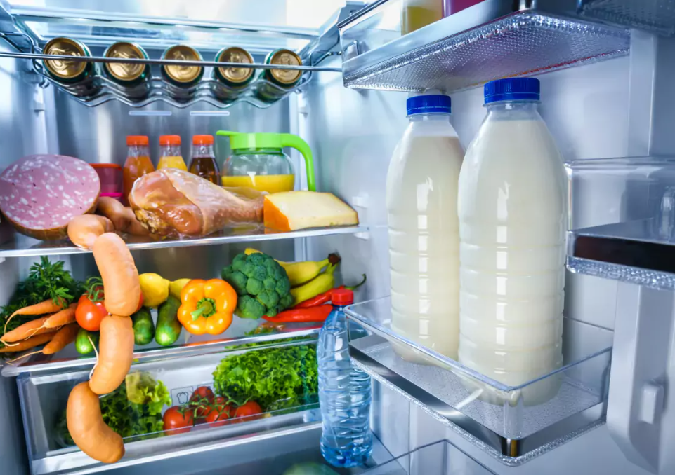
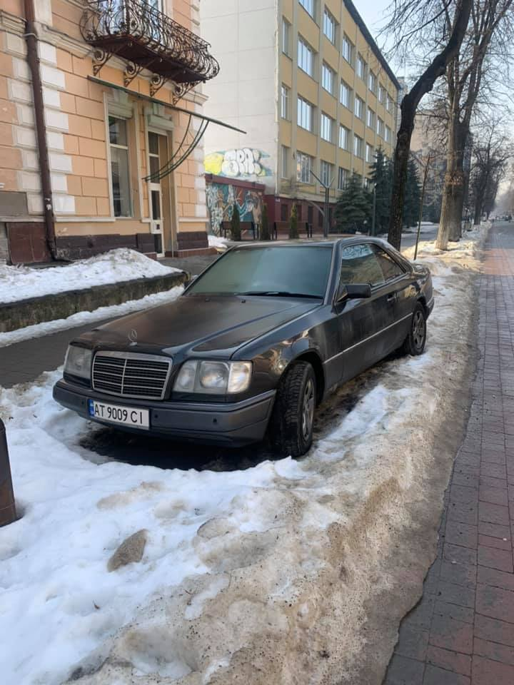

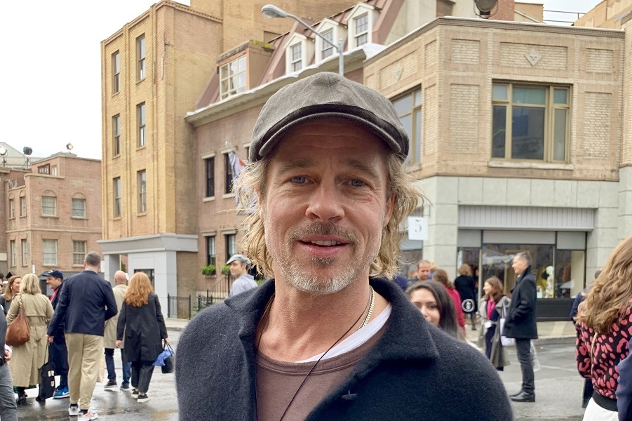
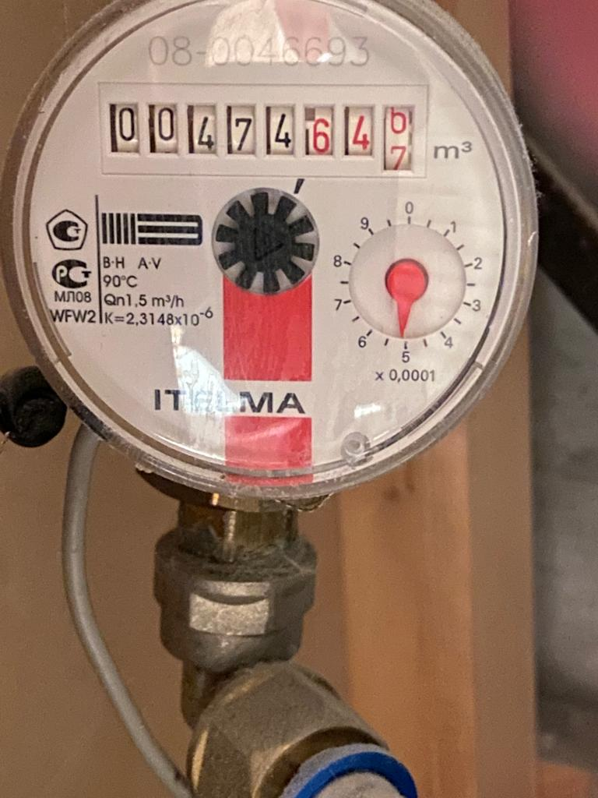
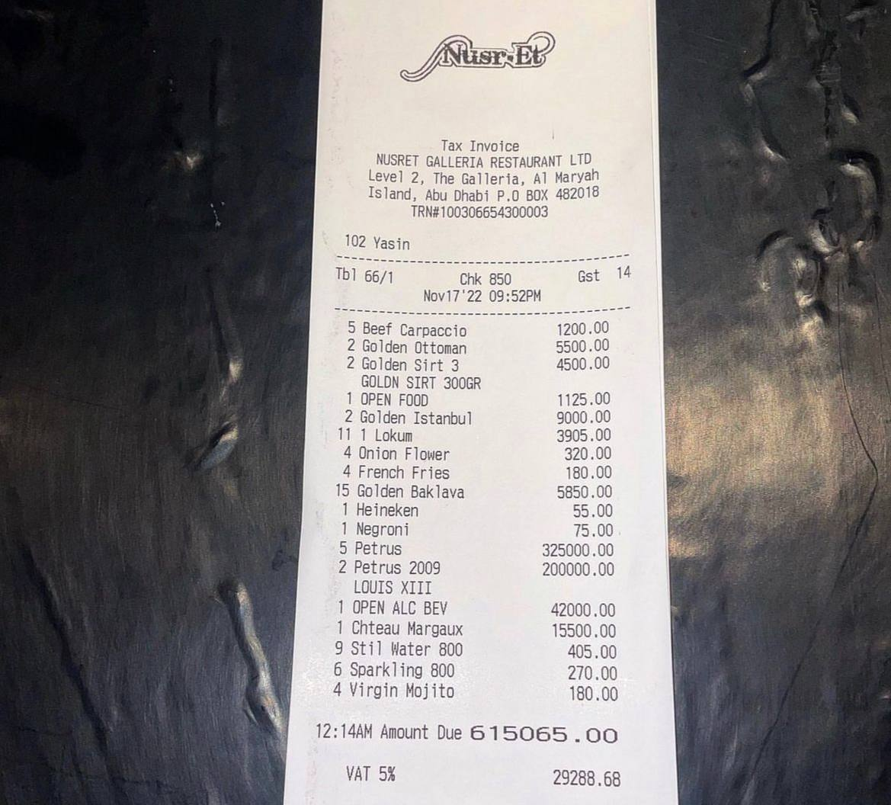
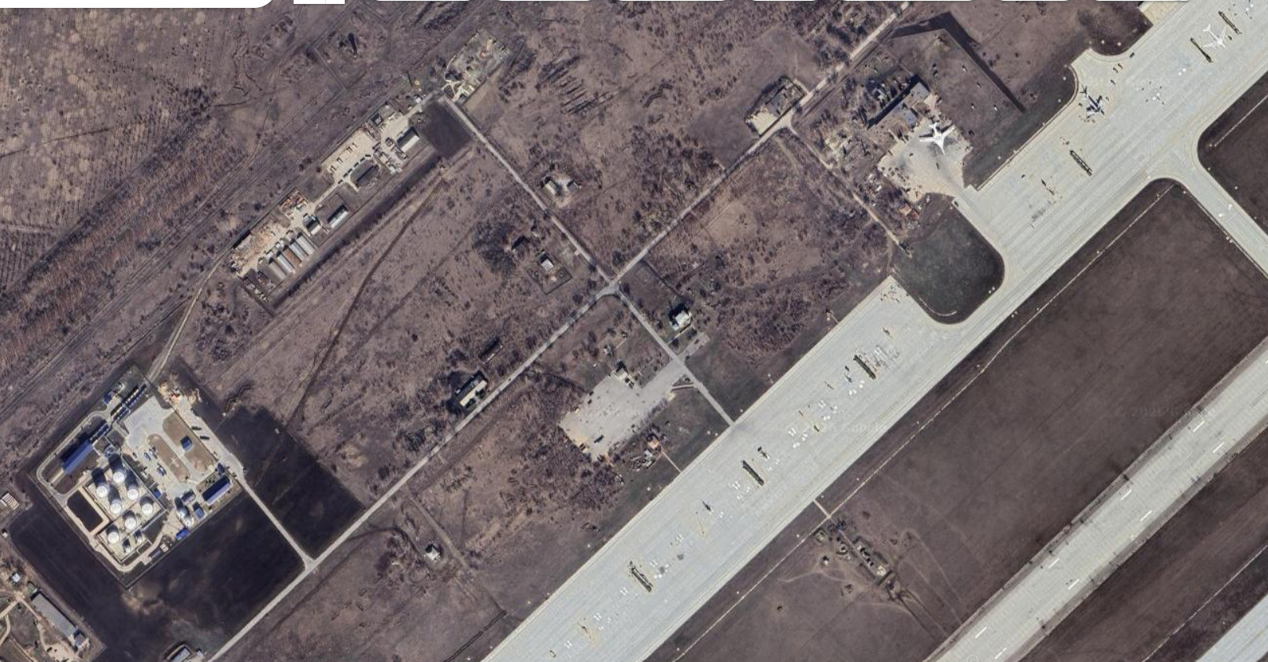
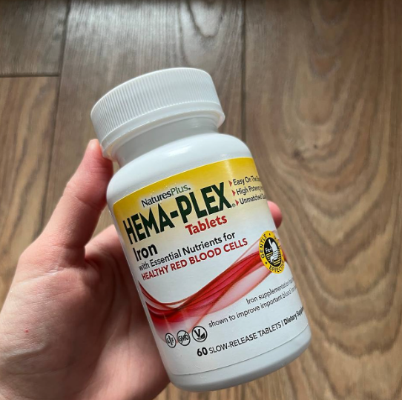
3. Handler Gallery
8 AI scenarios — each processes its own image type
🍽 Fridge Recipe
🚗 Car Valuation
🔍 Object Detection
👤 Person Description
food products → dish + full recipe
plate + make + violations + price USD
all large visible objects + counts
gender / age / build / hair / eyes
📊 Instrument Reading
🧾 Receipt Reading
🛰 Satellite Analysis
💊 Medicine Check
gauges, meters, dashboards
category + items + totals
landscape + area type + objects
drug info + dosage + warnings + price

Slide 5
4. Application Architecture
Data flow — from upload to result
📤 Upload
✅ Validate
📍 EXIF
📐 Resize
🤖 AI Call
🖼 Annotate
📦 Result
→
→
→
→
→
→
JPG/PNG/WEBP max 16 MB
Pillow verify + extension
GPS + datetime (before resize)
max 800×600 no upscale
Pydantic schema → Gemini API
Bboxes + model label
base64 inline nothing stored
Key architectural decisions
🔒 No Storage
tempfile.TemporaryDirectory — user files are never saved to disk
🧩 Scenario System
scenarios.py — new handler = 1 file + 1 line in the registry
🔌 Swappable AI Backend
ai_backends/{provider}.py — Gemini today, any other provider tomorrow
🖼 Inline base64
Annotation embedded in HTML — no URLs or files on the server

Slide 6
5. Experiment Metrics
What was done, how, and at what cost
~8
8
$0
0
hours of prompt coding
working AI scenarios
spent 100% free
lines of code written manually
Iterative development process
Iteration 1
Core structure: Flask + 3 handlers + Gemini backend
Iteration 2
Major refactor: 8 scenarios, preprocessors, EXIF, base64, tempfile
Iteration 3
Extensions: fridge recipe, car valuation, receipt category, satellite
Debugging
JSON truncation fix, response.parsed, max_output_tokens, object limit
Presentation
10-slide deck built via python-pptx — entirely through prompts, zero manual editing
Release
Example images, GitHub push, free hosting research & deploy — all via prompts

Slide 7
6. What Worked Well
Claude Code strengths — observations from practice
🧠 Understands full project context
⚡ Fast implementation speed
Reads all files at once, retains architecture. New handlers didn't break existing code.
New handler from scratch: ~5 min. Full module refactor: ~10 min.
🔧 Precise debugging from logs
📐 Follows architectural conventions
Show an error → get an exact fix. Not generic advice — specific edits in the right lines.
New code matches the project style: same patterns, variable names, file structure.
🔁 Iterative edits without breaking things
📚 Auto-documentation
“Remove this”, “Rename”, “Add field” — executed precisely, doesn't touch the rest.
CLAUDE.md and comments updated automatically when architecture changes.

Slide 8
7. What Didn't Work Well
Limitations and challenges of prompt coding
📏 Long AI responses get truncated
📝 Context window grows over time
JSON truncation at 20 KB. Satellite handler crashed with parse error. Fix: max 15 objects + max 8 words per description + max_output_tokens.
Longer sessions mean slower prompts and slower responses. Solution: open a new session and briefly restore context.
🔗 External dependencies can't be solved with a prompt
🧪 No automated tests — only manual checks
VIN lookup by plate — no free API exists. Lookalike / buy-links — hallucinations. AI cannot overcome real-world limitations.
Prompt coding doesn't yet cover TDD well. Every change needs manual validation — no regression safety net.
🎯 Vague prompt = vague result
🤖 Multi-step tasks need more iterations
Complex tasks require several iterations of clarification. The more precise the spec — the better the first-time result.
Claude Code works best with atomic tasks. Large refactors sometimes needed 2–3 correction rounds.

Slide 9
8. Monetization Potential
Scaling this approach into a product
📱
🎯
🔑
🤖
Mobile Apps
Deep Prompt Refinement
Paid API = Unlimited Scale
Multi-Model Strategy
▸ Build a native mobile app per scenario
▸ Each prompt/scenario can be polished
▸ Remove free-tier rate limits
▸ Paid keys unlock GPT-4, Claude Opus
▸ Each prompt = one focused app
▸ Better annotation = higher user value
▸ Handle any volume of requests
▸ Let users choose the AI model
▸ App Store / Google Play distribution
▸ Fine-tune for specific industries
▸ Pay-per-use or subscription model
▸ Better model = better results
▸ Low dev cost via prompt coding
▸ Premium quality = premium price
▸ Scale is only limited by demand
▸ Competitive differentiation
💡 Best starting point:
a focused mobile app with a single polished scenario — zero AI cost via free key, monetized through App Store listing and in-app upgrades.

Slide 10
9. Experiment Conclusions
Key takeaways from prompt coding
✅ Hypothesis confirmed:
a real production-ready web app can be built entirely through prompts.
Key takeaways:
Prompt coding genuinely saves time on boilerplate and routine tasks
The clearer the developer’s architectural vision — the better the output
Claude Code retains full project context — that’s the key advantage
Iterative approach works: small prompt → check → next step
Not a replacement for the developer — an amplifier. Architecture stays with the human
Hallucinations are real: external data and links need manual verification
📡 Next step:
deploy to Render (free) → public URL → share as an AI capabilities demo

